Slide 1

ECE6850 Project
Interesting data analysis of LA arrest data
Zeyu Liu

Slide 2
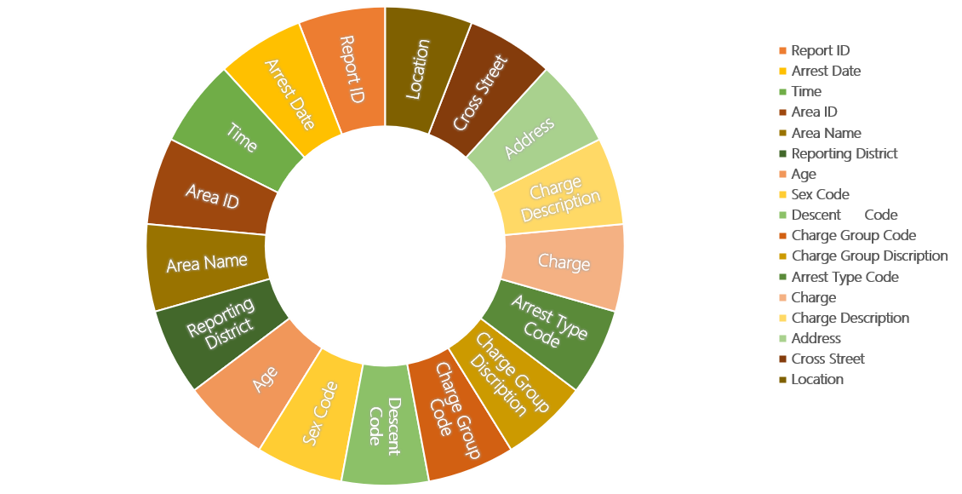
Contents Arrest_Data_from_2010_to_Present_in_Los_Angeles
Arrest

Slide 3
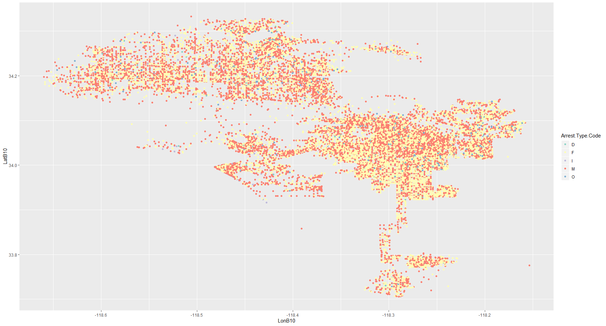
LA arrest map in 2018

Slide 4
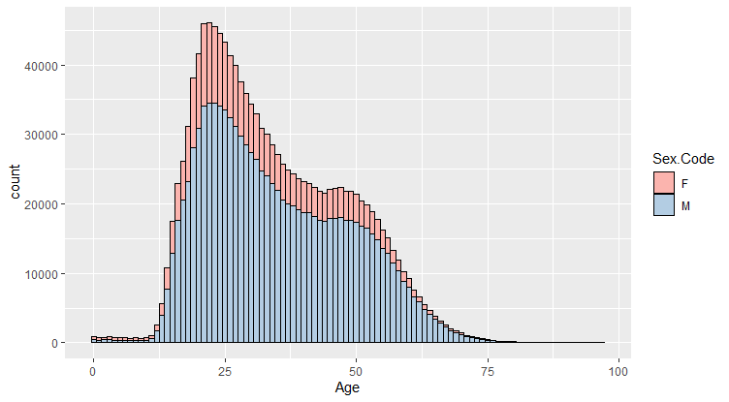
The arrest data compare with the Age and Sex

Slide 5
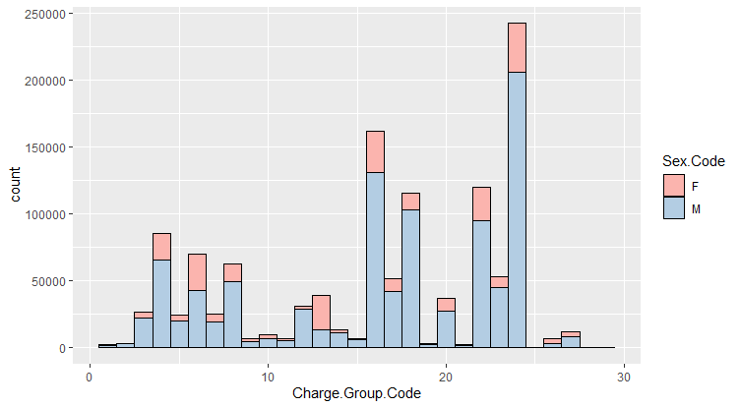
The arrest data compare with the Charge.Group and Sex

Slide 6
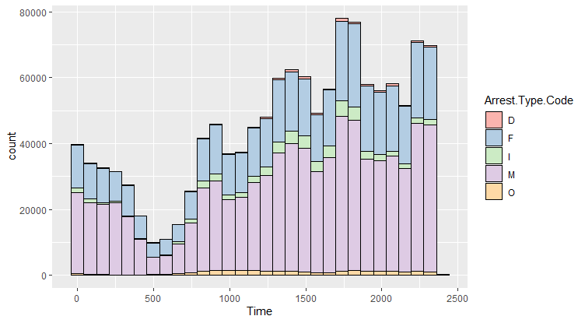
The arrest data compare with the Time and Arrest.Type

Slide 7
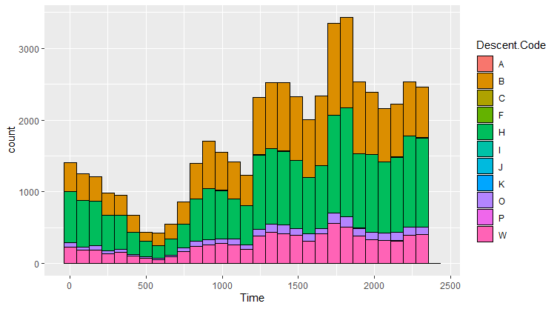
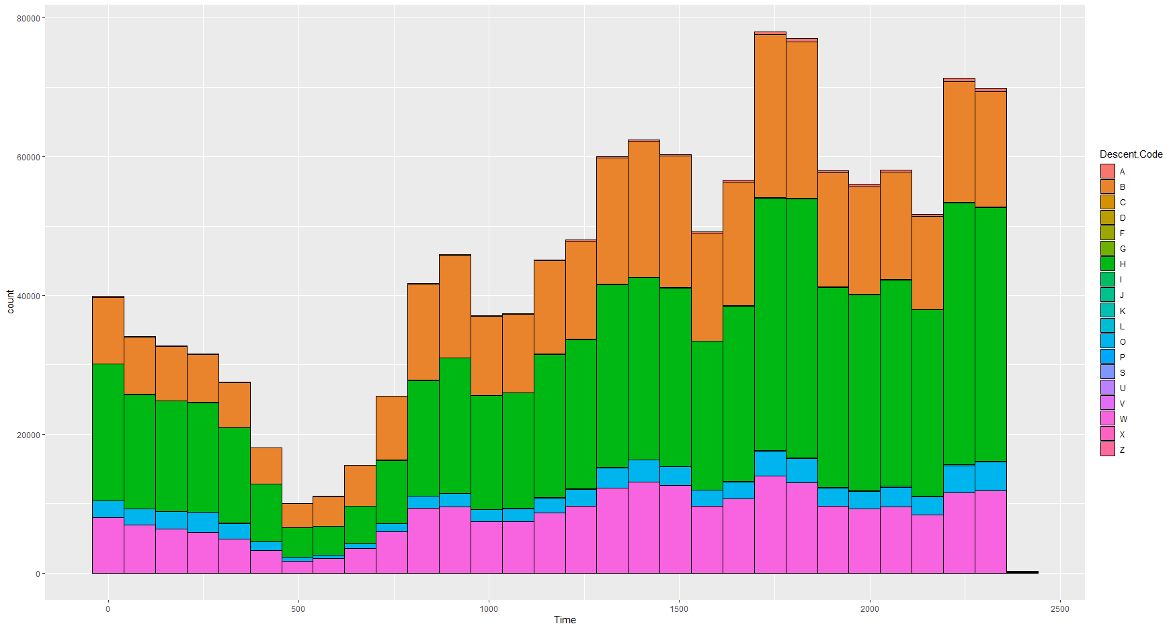
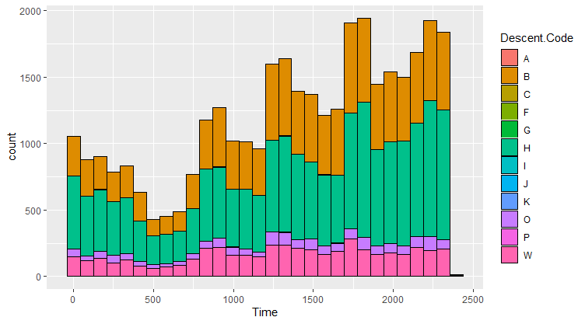
The arrest data compare with the Time and Descent.Code
Descent Code:
A - Other Asian B - Black C - Chinese D - Cambodian F - Filipino G - Guamanian H - Hispanic/Latin/Mexican I - American Indian/Alaskan Native J - Japanese K - Korean L - Laotian O - Other P - Pacific Islander S - Samoan U - Hawaiian V - Vietnamese W - White X - Unknown Z - Asian Indian

Slide 8
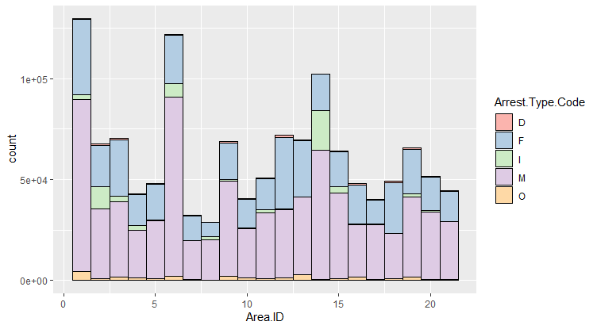
A code to indicate the type of charge the individual was arrested for.
D - Dependent
F - Felony
I - Infraction
M - Misdemeanor
O – Other

Slide 9
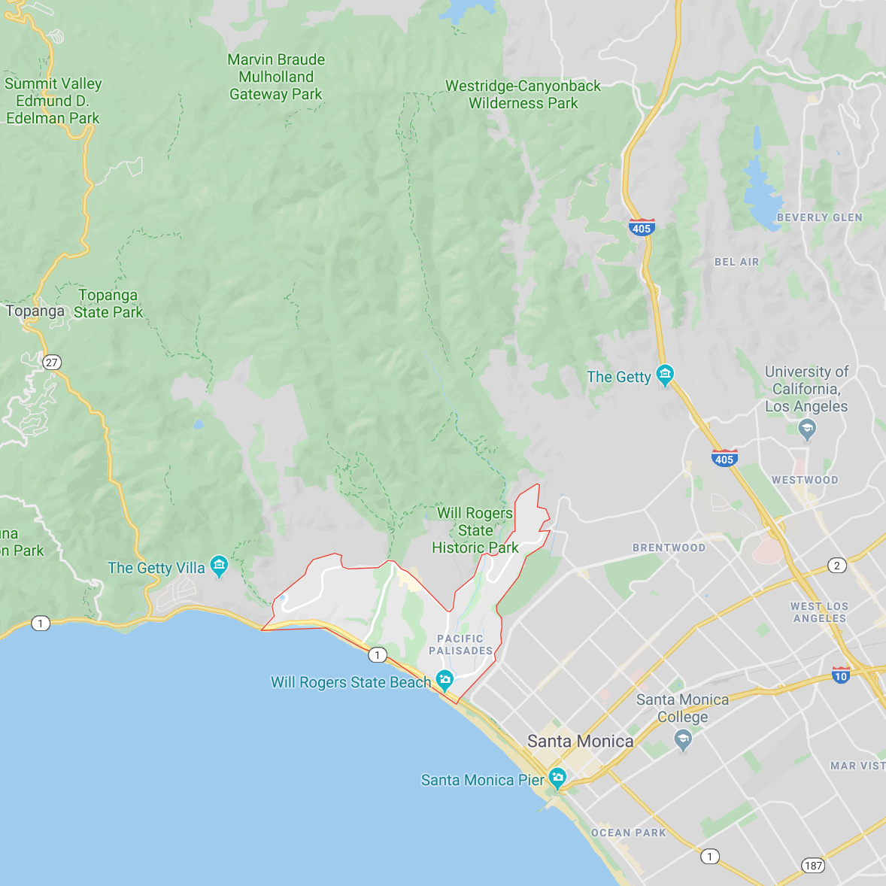
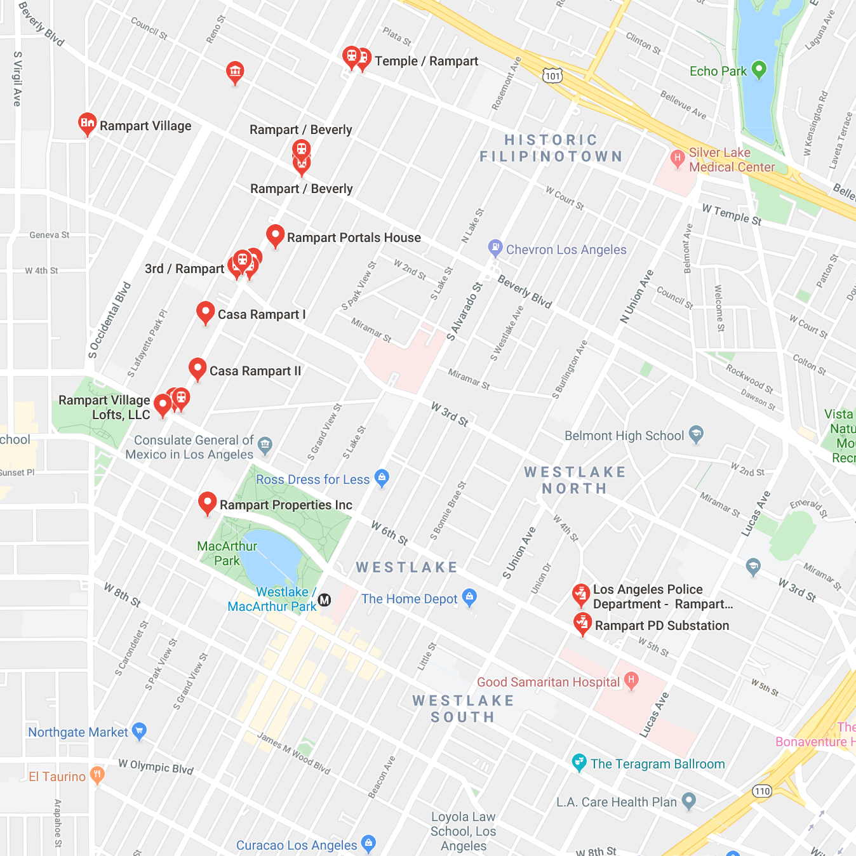
PACIFIC
RAMPART

Slide 10
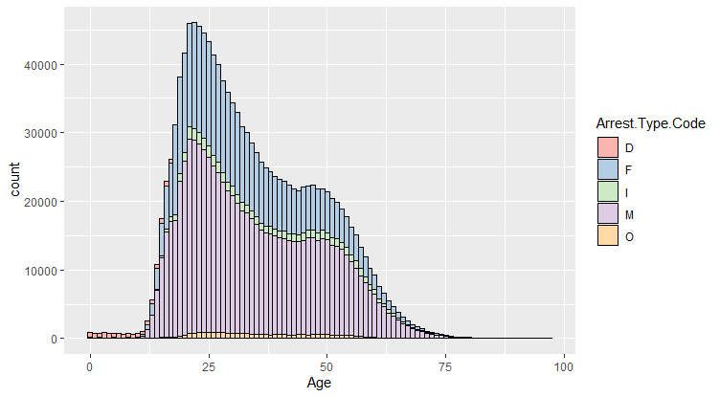
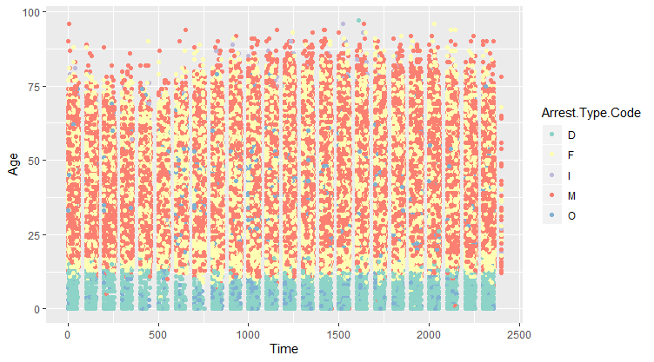
D and I can be divided by the age
Most arrests under an age are D

Slide 11
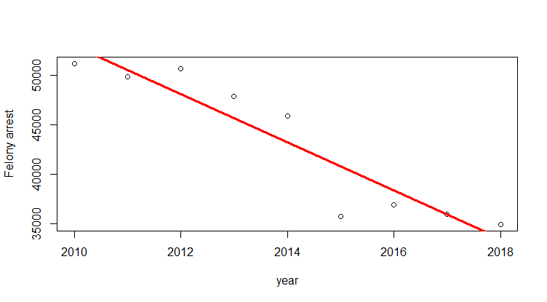
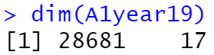
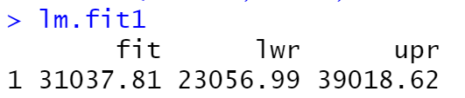
Linear regression prediction for the Arrest in 2019

Slide 12
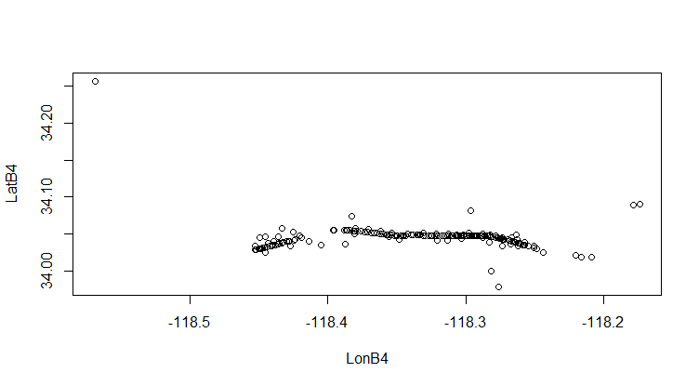
What’s the number of arrest incidents per kilometer on Pico Boulevard in 2018?
Arrest location with the Pico Boulevard address

Slide 13
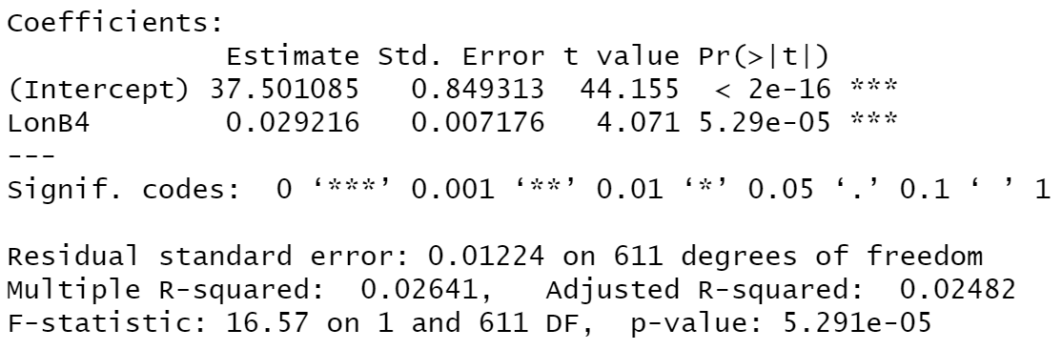
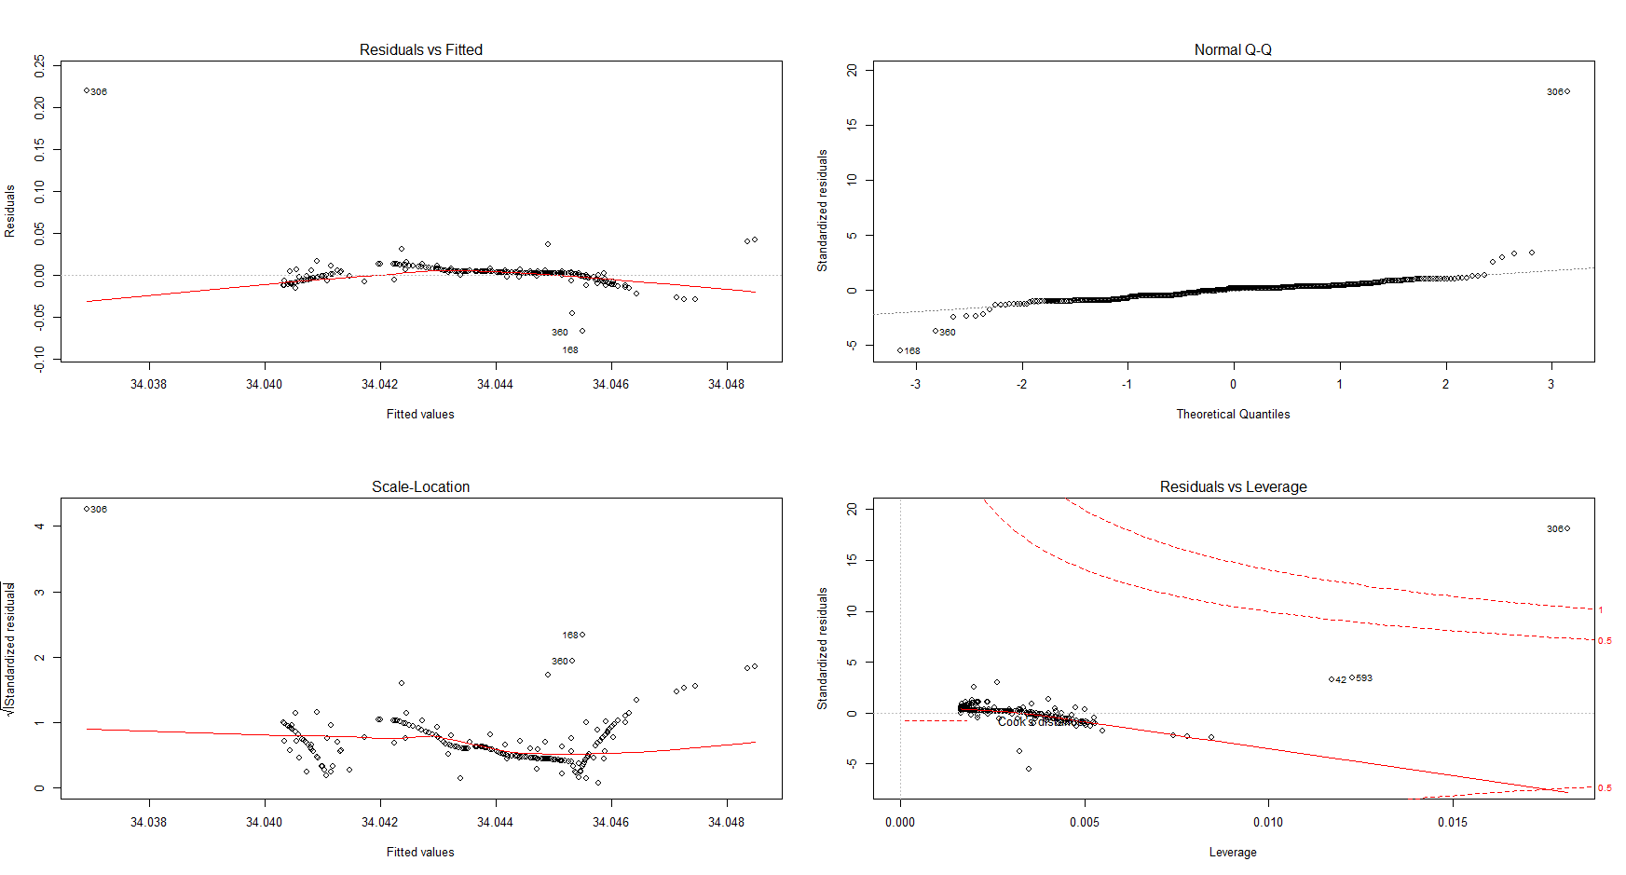
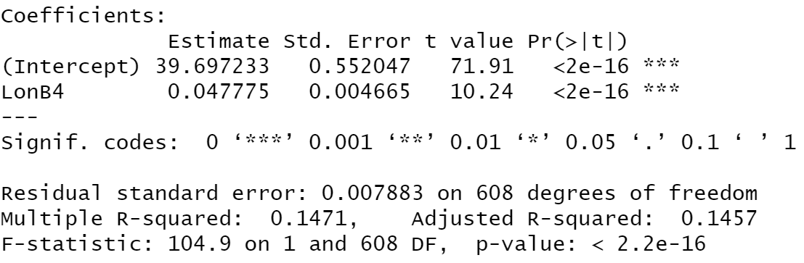
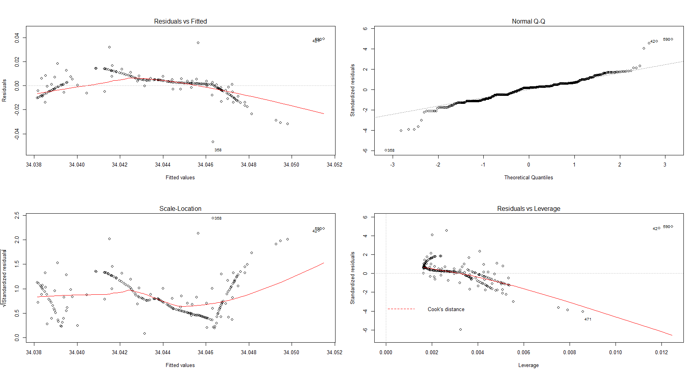
Remove the outliers, Let it be linear

Slide 14
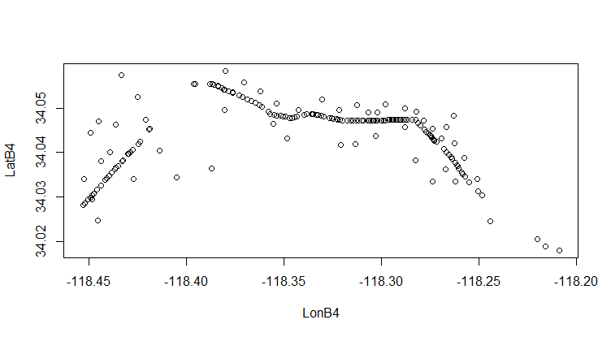
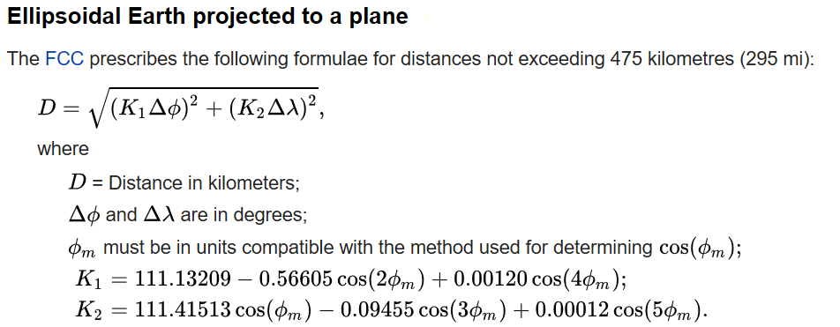
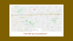
D = 16.83 km
602/D = 35.77 A/km

Slide 15
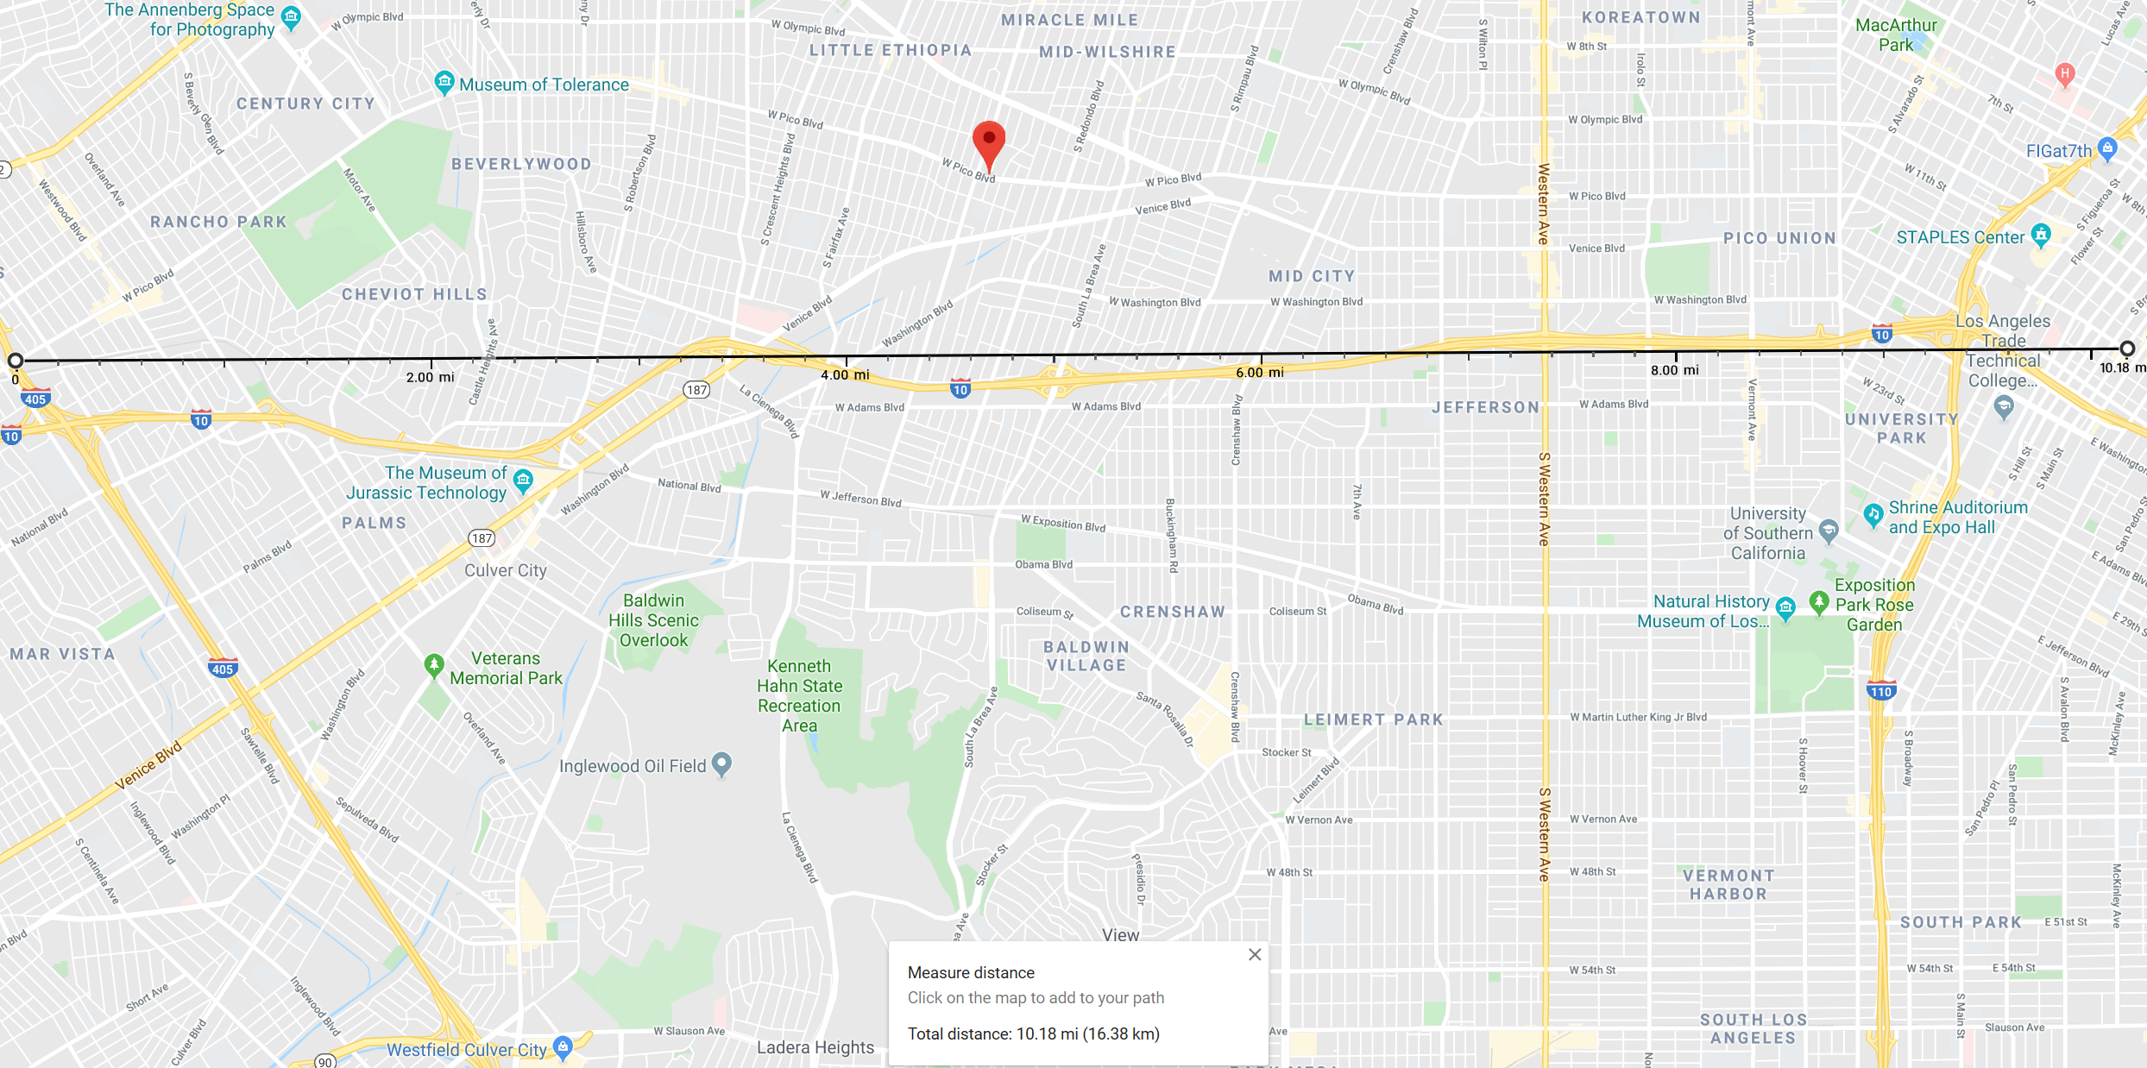
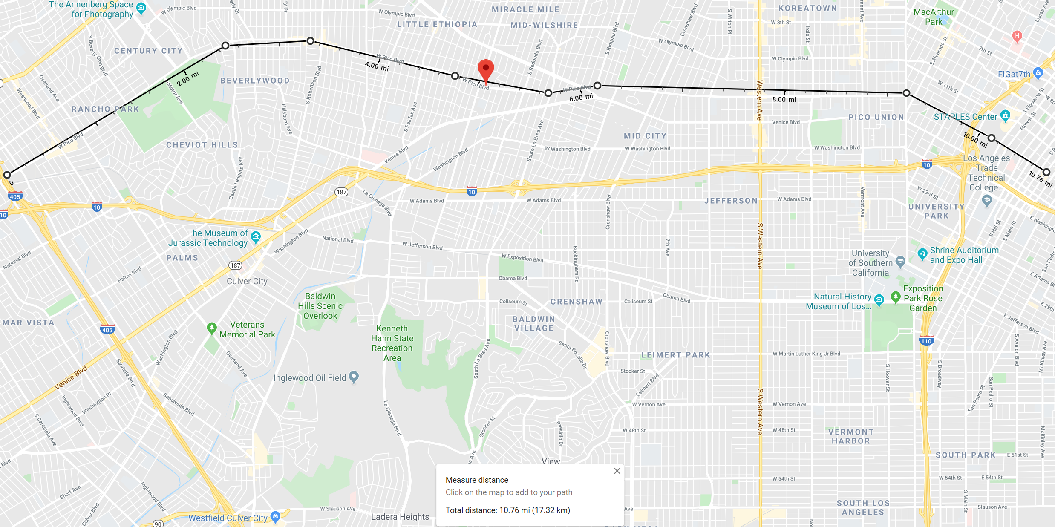
How well was my prediction?

Slide 16
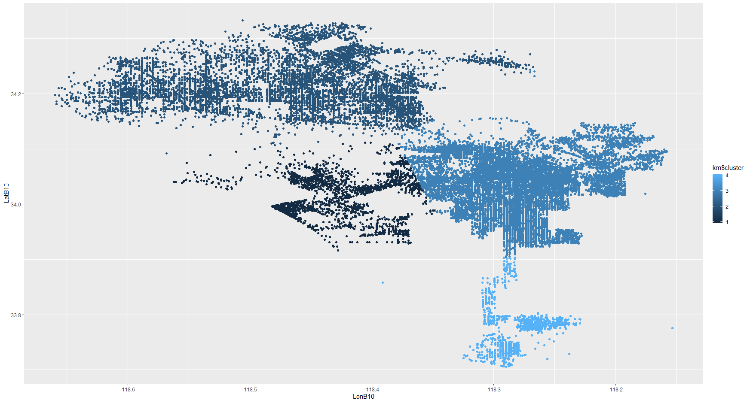
K-means Cluster, K = 4

Slide 17
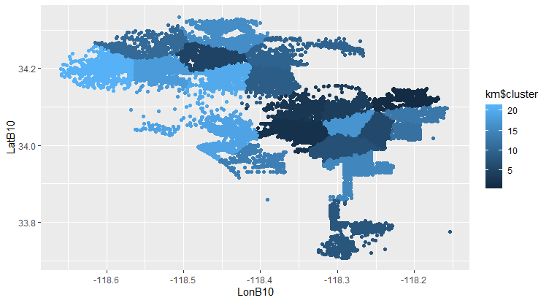
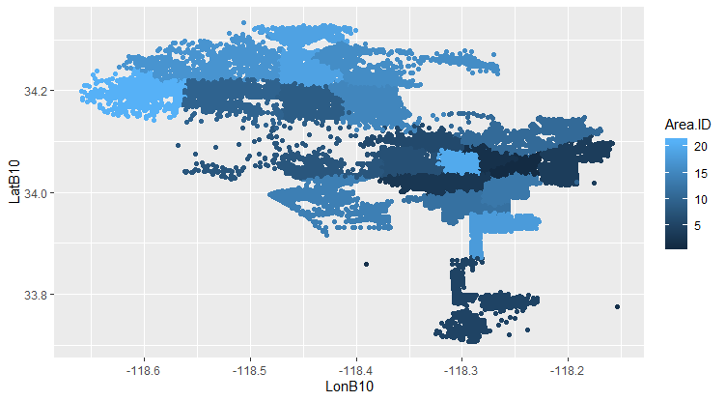
K-means Cluster, K = 21
Real 21 Areas distribution

Slide 18

References
Code of Federal Regulations (annual edition). Title 47: Telecommunication. 73.208. October 1, 2016. Retrieved 8 November 2017.
Wickham, Hadley (July 2010). "ggplot2: Elegant Graphics for Data Analysis". Journal of Statistical Software. 35 (1).

Slide 19
Thank you !
Interesting data analysis of LA arrest data
Zeyu Liu

